Slide 1



Machine Learning
Reinforcement
IPL Match Prediction
Manikandan Ayyasamy
May 20 2025
DA/DS – November 2025
Next slide

Slide 2


02
Objective
To predict the winner of an IPL match after preprocessing the dataset.
To compare various machine learning models (Logistic Regression, SVM, KNN, Decision Trees, Random Forest, and XGBoost) for predicting the match outcomes based on key features.
To demonstrate the process of evaluating model performance and tuning hyperparameters for improved accuracy.
To summarize the key findings and propose the best model for IPL match prediction.
Next slide

Slide 3
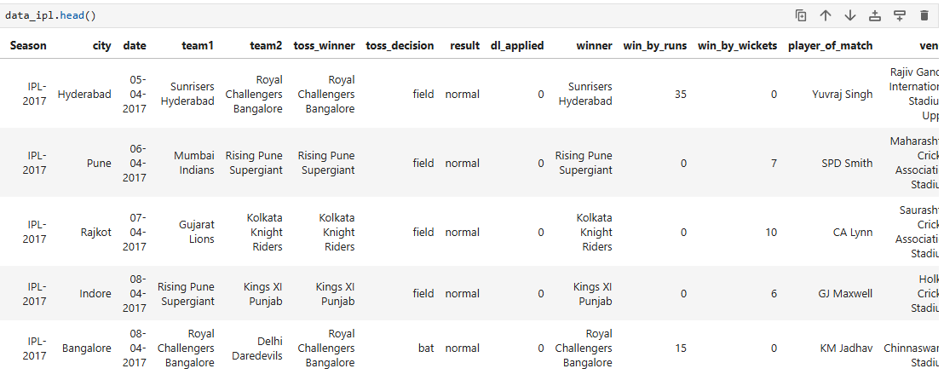
03
Data Understanding
The dataset contains 18 columns in total with 756 rows related to the IPL Matches from Season 2008 – 2019. The columns are id, Season, city, date, team1, team2, toss_winner, toss_decision, result, dl_applied, winner, win_by_runs, win_by_wickets, player_of_match, venue, umpire1, umpire2 and umpire3.
Categorical Columns - 14
Numerical Columns - 4
Next slide

Slide 4



04
Data Cleansing and Encoding
Null Values
Handling Outliers
Label Encoding
6 Columns had null values totaling – 656 null values.
Bifurcation:
Umpire 3 - 637
City – 7
Winner – 4
Player of match – 4
Umpire1 – 2
Umpire2 – 2
The null values were handled by replacing them with mode and “No Results” based on the column and the context.
Outlier values such as spelling mistake in the team names were corrected.
Since the predictors cannot be categorical values, they were converted to numerical data using value mapping and Label encoding.
Label Encoding for Team names.
One-Hot Encoding for the results which confirms whether the results are normal, tie or no result using Boolean values.
Next slide

Slide 5
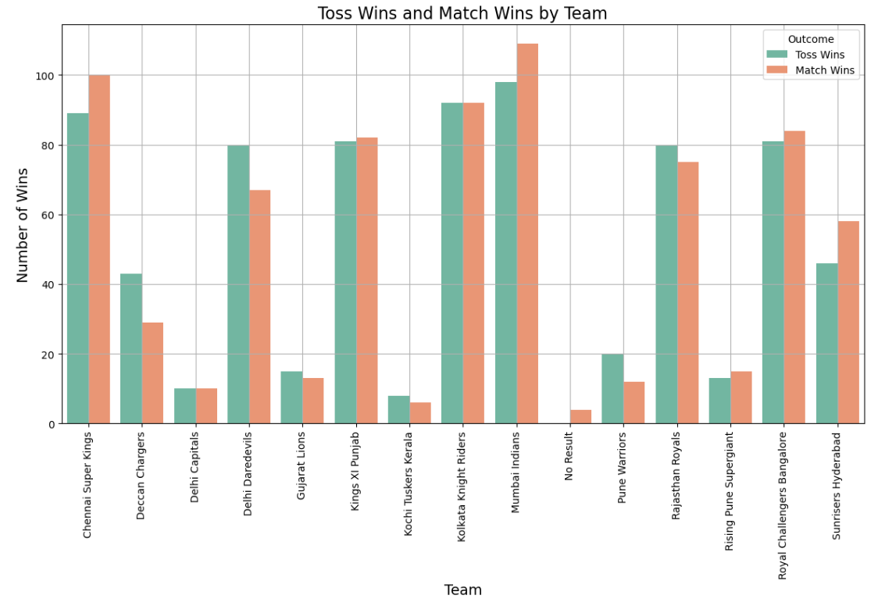
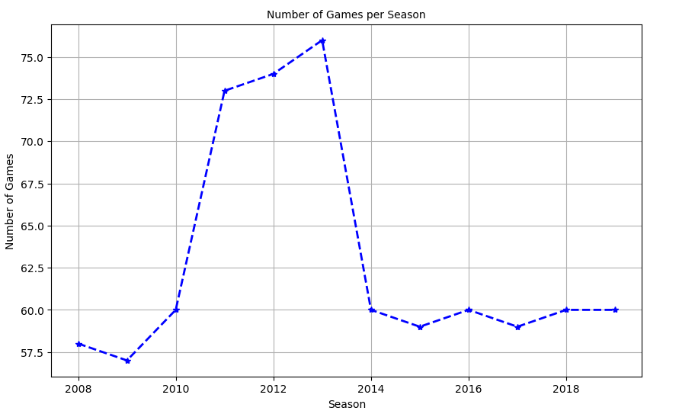
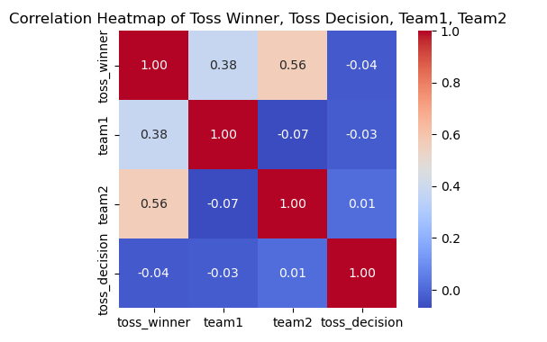
05
EDA
Next slide

Slide 6

Model Evaluation
06
Features – Predictors used in the Model evaluation are Season, city, date, team1, team2, toss winner,toss decision,dl applied, umpire1, umpire2, umpire3, result normal, results tie.
Target – Winner
Training data size – 70%
Testing data size – 30%
Random State = 8
Scaler – MinMaxScaler

Slide 7

07
Model - 1
Logistic Regression
Accuracy score of training is 34%
Accuracy score of testing was 24%
Hyper-Parameter Tuning used: Grid Search
Accuracy score of testing after Hyper-Parameter tuning is 26%
Why Not Logistic Regression?
Sensitive to Imbalanced data
Relationship between the features
Lot of Encoding
Next slide

Slide 8
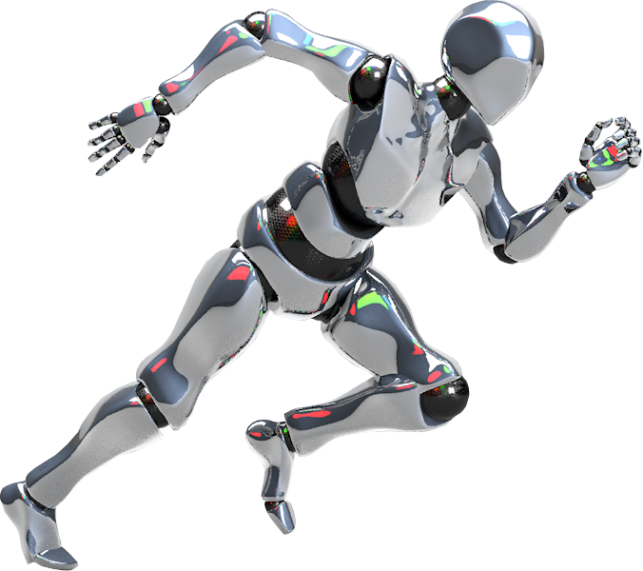
08
Model - 2
Support Vector Machine - Classifier
Accuracy Score of SVM – Classifier Before Hyper-Parameter tuning was 26%
Hyper-Parameter tuning used: Grid Search
Accuracy Score of SVM – Classifier after Hyper-Parameter tuning is 36%
Why Not SVM- Classifier?
Low Accuracy Score
Sensitive to Imbalanced data
Non-Linear Pattern
Next slide

Slide 9
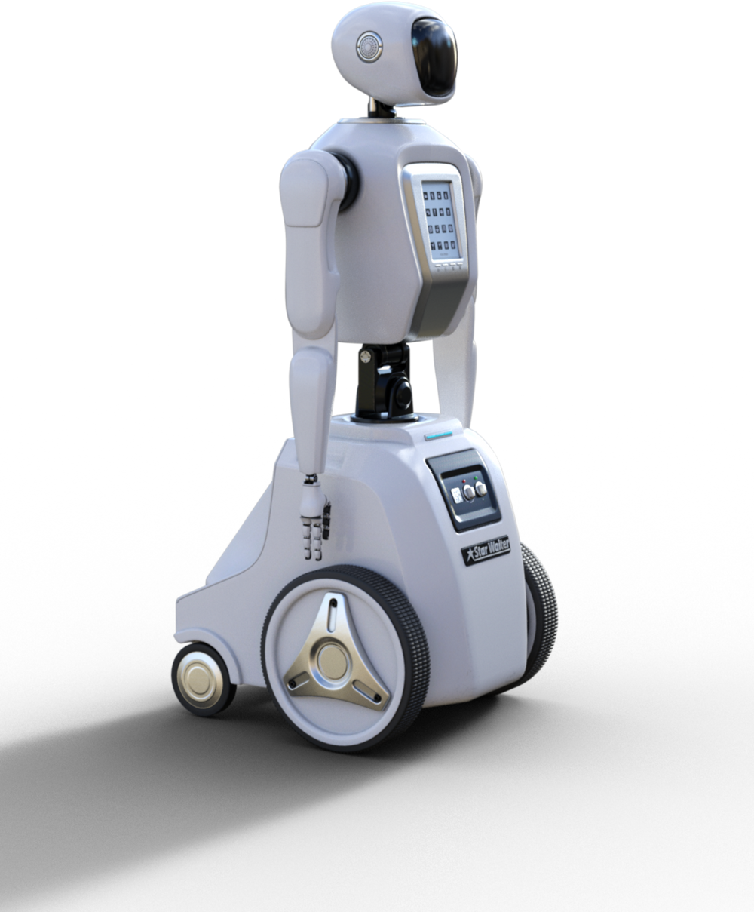
Model - 3
KNN - Classifier
09
Accuracy Score for KNN – Classifier was 20%
K value – 10
Hyper Parameter Tuning used: Grid Search
Accuracy Score for KNN – Classifier after Hyper-Parameter tuning is 22%
Why Not KNN - Classifier?
Handling Categorical data
Non – Linear Relationship
More & Complex Features
Next slide

Slide 10

10
Model - 4
Decision Tree
Accuracy Score of Decision Tree Classifier before Hyper-Parameter Tuning was 75%
Hyper-Parameter Tuning method used: Grid Search
Accuracy Score of Decision Tree Classifier after Hyper-Parameter Tuning is 83%
Why Decision Tree?
Handling Categorical data and Imbalanced data
Non – Linear Relationship
Structurization
Next slide

Slide 11

11
Model - 5
Random Forest
Accuracy Score of Random Forest Classifier before Tuning was 73%
Hyper-Parameter Tuning used: Grid Search
Accuracy Score of the Random Forest Classifier after tuning is 81%
Why Random Forest?
Reduced Overfitting
Handling Categorical data
Robust to noise
Next slide

Slide 12
Model - 6
12
XGBoost Classifier
Accuracy Score of XGBoost Classifier before Tuning was 92%
Hyper-Parameter Tuning used: Randomized Search
Accuracy Score of the XGBoost Classifier after tuning is 94%
Why XGBoost?
Why Randomized Search?
Feature Interaction
Non-Linear Relationship
Efficiency
Easy Coverage
Next slide

Slide 13

Model Comparison
13
Models | Accuracy before Tuning | Hyper-Parameter Tuning | Accuracy after Tuning | Acceptance
Logistic Regression | 24% | Grid Search | 26%
SVM - Classifier | 26% | Grid Search | 36%
KNN - Classifier | 20% | Grid Search | 22%
Decision Tree | 75% | Grid Search | 83%
Random Forest | 73% | Grid Search | 81%
XGBoost Classifier | 92% | Randomized Search | 94%
Next slide

Slide 14

Insights
14
Logistic Regression: Low accuracy (24%) — suggesting linear models struggle with complex patterns in the IPL match data, possibly due to non-linear relationships.
SVM: Initial accuracy was low (26%), but after hyperparameter tuning (Grid Search), the accuracy slightly improved (~36%). This shows SVM isn't a good fit for this problem, especially because the data set has non-linear relationships that SVM struggles to capture.
KNN: Even after Elbow method tuning for the optimal K value, accuracy remained low (20-22%). This indicates that KNN might not be capturing the right patterns in this dataset, possibly due to more feature availability.
Decision Tree: Showed a marked improvement after hyperparameter tuning, with accuracy increasing from 75% to 83.7%. Decision Trees can capture non-linear patterns.
Random Forest: Similar to Decision Trees, Random Forests showed a strong performance, increasing accuracy from 73.13% to 81.93% after tuning.
XGBoost: The highest performing model initially with 92% accuracy, slightly increased to 94% after hyperparameter tuning. XGBoost performed exceptionally well, benefiting from its boosting technique and ability to handle complex feature relationship in the data.
Next slide

Slide 15
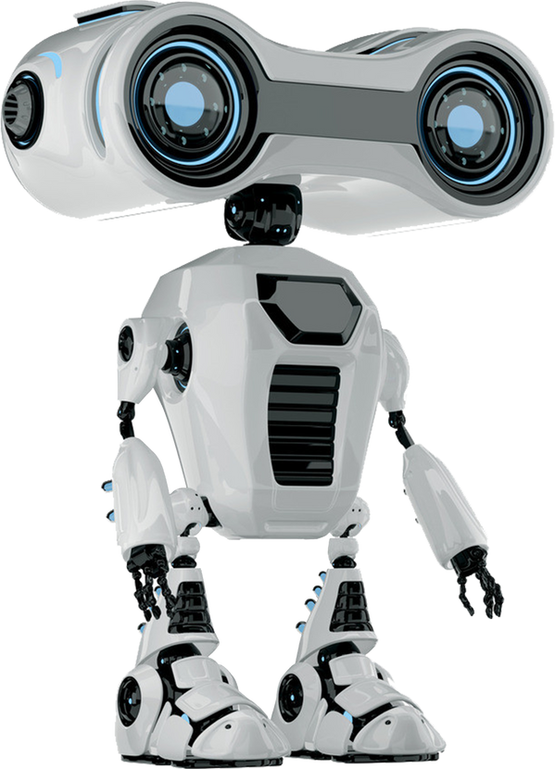
15
Conclusion
Random Forests and Decision Trees are also strong candidates, but XGBoost consistently outperformed others and offers better generalization, making it the top choice for IPL match prediction
The best-performing model for this dataset is XGBoost, thanks to its ensemble boosting technique, ability to capture complex, non-linear relationships.
Adding context-rich features like team form, head-to-head stats, or home advantage could significantly improve accuracy.
Using advanced encoding techniques like one-hot or label encoding for categorical variables avoids misleading the model but creates large space.
Cleaning low-importance features and balancing the dataset helps reduce noise and model bias, leading to more generalizable results.

Slide 16
Thank You!
Machine Learning is the last invention that humanity will ever need to make.

